Slide 1
Diversity in Enrollment in Community Colleges in the Portland Metropolitan Area
Spring 2016

Slide 2

College in the Portland Area
The Portland metropolitan area benefits from a wide array of public and private colleges. By far, most students are enrolled at one of the local community colleges.

Slide 3
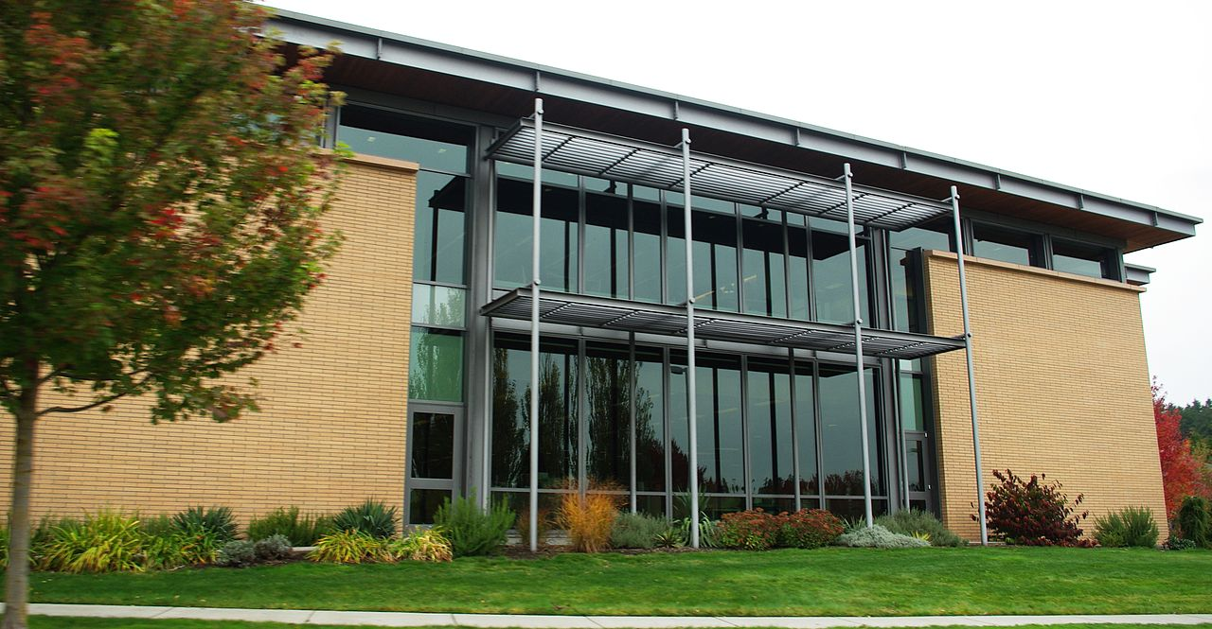
PCC
Portland Community College (PCC) is the largest, with four full fledges campuses and several smaller learning centers. In 2014, over 30,000 students attended Portland Community College. PCC offers certificate programs, Associates degree programs through 149 major areas.

Slide 4
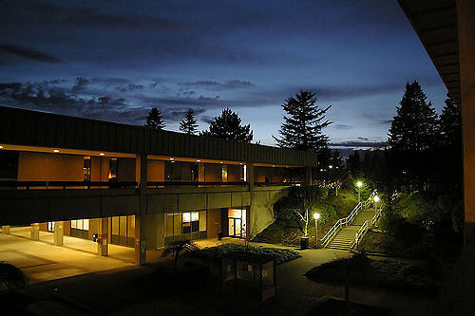
MHCC
Mt Hood Community College (MHCC) serves students who live north and east of Portland proper. In 2014, over 9,000 students attended MHCC. Mt Hood offers certificate programs, Associates degree programs with 99 different majors.

Slide 5
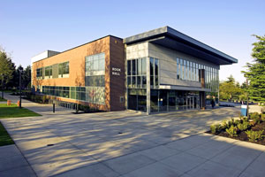
CCC
Clackamas Community College (CCC) serves students who live south of the Portland area. In 2014 over 7,000 attended CCC. They were offered certificate and Associates degree programs with a possibility of 88 majors.

Slide 6
Diversity in Enrollment
Each college has plans to increase diversity in both students and employees to more closely reflect the population of the metropolitan area.

